Slide 1
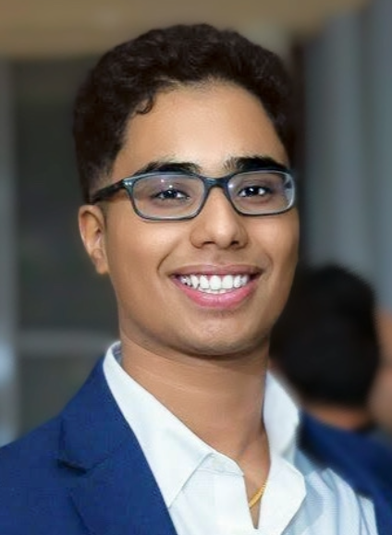
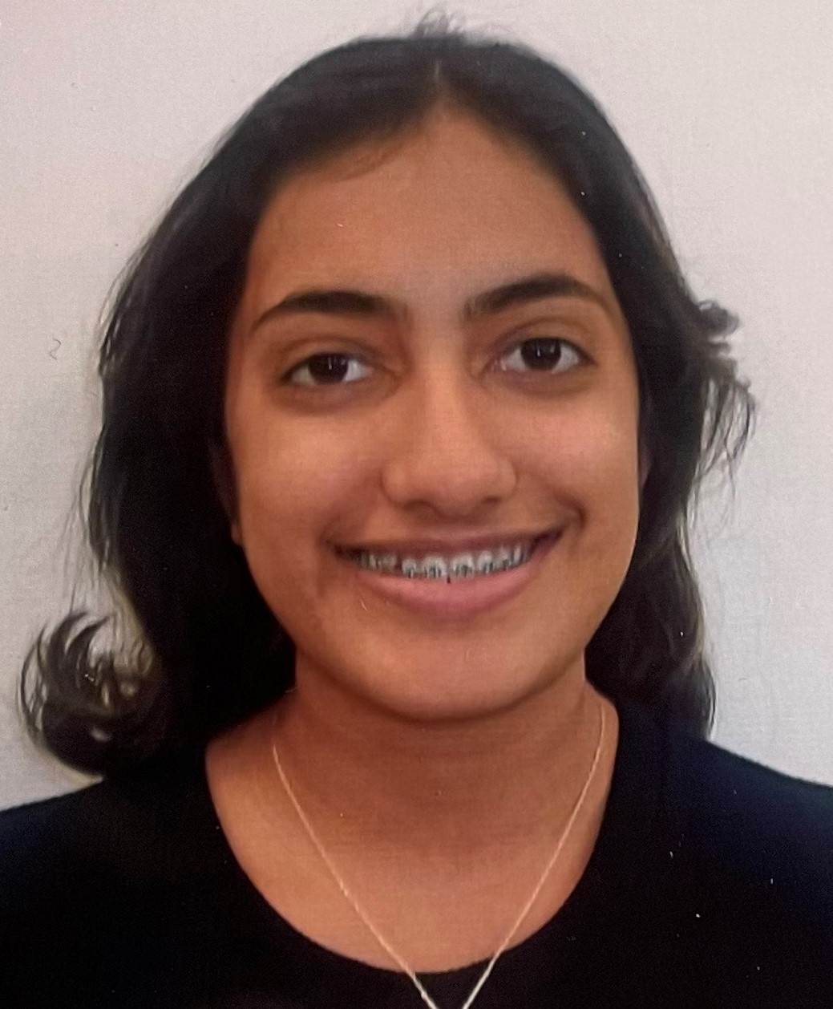
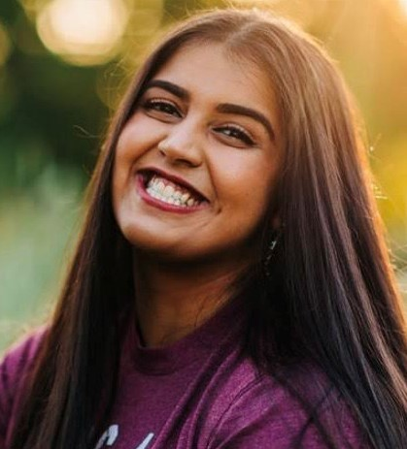
2021 High School Achievement Award*
Pratheek Kuimanda is the son of Kuimanda Joyappa and Malchira Barathi from Spring, TX (previously from Andover, MA). Among his many other accomplishments, during the COVID pandemic last year, he founded a Andover PPE team, and designed, produced & delivered face shields to many hospitals all over Boston area. For this work, he was recognized in the local newspapers and media. He will be pursuing his undergraduate degree this fall at Rice University in TX, in Public Health and Sports Medicine.
1st Place Winner
Riya Machimada is the daughter of Jeevan and Muthamma Machimada from Greer SC. Aside from studies and other accomplishments, she is a tennis player, certified EMT and over the past four years was a dedicated volunteer at Roper Mountain Science Center helping kids. She will be pursuing her undergraduate degree this fall at University of South Carolina, in Biological Sciences.
2nd Place Winner
Chelsea Andrade is the daughter of Keerthan and Janetha Andrade (Butiyanda family) from Katy, TX. During her high school years she has been into varsity wrestling, Bollywood dancing and Indian Cultural Socity. She will be pursuing her undergraduate degree this fall at Texas A&M University in pre-med Psychology.
3rd Place Winner
Kodava Koota Board and Advisory/Evaluiation Committee Members

